Slide 1
KMP Knuth Morris Pratt Algorithm
Mostafa Saad Ibrahim
Teaching Assistant @ Cairo University
Software Engineer @ NTPSoftware

Slide 2
Pattern Matching
Problem: Given a string S, pattern P, find all P in S
S = abababcabaddd, P = aba
2 matches: abababcabaddd

Slide 3
Brute Force
Let: n = length(S) and m = length(P)
Try every location in S, and check of it matches P
For i = 0 to n-m
Let t = S[i, …i+m-1] => Substring from S
If equal(P, t)
Display, we found a match
Order (nm)

Slide 4
Brute Force Example
a | b | a | b | a | b | c | a | b | a | d | d | d
a | b | a
a | b | a
a | b | a
a | b | a
a | b | a
a | b | a
and so on

Slide 5
Hmm
Simple
Big order
Much redundancy
E.g. if m = 5, We compare positions: 3 4 5 6 7
and then compare: 4 5 6 7 8
A clever solution should avoid redundancy
KMP does so

Slide 6
Helpful terminology
Prefix of S
Any string that start from first character
Proper Prefix of S
Any prefix of S, except S itself
Then a string of 1 letter, has no proper prefixes
Suffix of S
Any string that ends at last character
Proper Suffix of S
Any suffix of S, except S itself

Slide 7
Example: S = abcdef
Prefix of S: n prefixes
PL = {a, ab, abc, abcd, abcde, abcdef}
Proper Prefix of S: n-1 prefixes
PPL = {a, ab, abc, abcd, abcde}
Suffix of S: n suffixes
SL = {abcdef, bcdef, cdef, def, ef, f}
Proper Suffix of S : n-1 suffixes
PSL = {bcdef, cdef, def, ef, f}
I did not consider the empty string case for some reasons

Slide 8
Prefix function
Given String P of length m, define an array F[m]:
Let t = P[0..i]
F[i] = length of longest proper prefix of t that is suffix of t
Other popular name: Failure Function
Some references exclude ith position in calculation, hence F has different numbers

Slide 9
Prefix function: ababcaba
i = 0, F[0] = 0 => by definition
i = 1 => t = ab => F[1] = 0
PPL = {a}
SL = {ab, b}
i = 2 => t = aba => F[2] = 1
PPL = {a, ab}
SL = {aba, ba, a}
i = 3 => t = abab => F[3] = 2
PPL = {a, ab, aba}
SL = {abab, bab, ab, b}

Slide 10
Prefix function: ababcaba
i = 4 => t = ababc => F[4] = 0
PPL = {a, ab, aba, abab}
SL = {ababc, babc, abc, bc, c}
i = 5 => t = ababca => F[5] = 1
PPL = {a, ab, aba, abab, ababc}
SL = {ababca, babca, abca, bca, ca, a}
i = 6 => t = ababcab => F[6] = 2
PPL = {a, ab, aba, abab, ababc, ababca}
SL = {ababcab, babcab, abcab, bcab, cab, ab, b}

Slide 11
Prefix function: ababcaba
i = 7 => t = ababcaba => F[7] = 3
PPL = {a, ab, aba, abab, ababc, ababca, ababcab}
SL = {ababcaba, babcaba, abcaba, bcaba, caba, aba, ba, a}
Then F[] = {0, 0, 1, 2, 0, 1, 2, 3}

Slide 12
Prefix function: ababcaba
a | b | a | b | c | a | b | a
i=3
When i = 7
First 3 = last 3
= aba
i=5
i=7
0 | 0 | 1 | 2 | 0 | 1 | 2 | 3

Slide 13
Prefix function: aaaaaaaa
a | a | a | a | a | a | a | a
0 | 1 | 2 | 3 | 4 | 5 | 6 | 7
Remember:
longest proper prefix = suffix
NOT
longest prefix = suffix

Slide 14
Prefix function
Later we will now why named also Failure function.
For now, assume we calculate this table using Brute Force
Later, an O(m) implementation

Slide 15
KMP Observation?
Let’s back to pattern matching
Say we have pattern P = ababcaba and we want to search inside string abababcabaddd
BF will try matching from position 0, and will match 4 characters then fail with c letter.
Now, it will try to match from 1, however, we already know the 3 matched characters from 1(bab).
Could we make use of that?

Slide 16
KMP Observation?
a | b | a | b | a | b | c | a | b | a | d | d | d
i = 0
i = 1
We already know that we match these 3 letters…
How to make use of that?

Slide 17
KMP Target
After matching t letters and failing, instead of trying next position, could we jump to next promising position?
Next vs Promising?
In other words, the t letters of pattern P, are prefix of P. Could we do minimum left shift of k letters to have next matching?

Slide 18
KMP Question?
Say we have pattern P = aaaaabc and we want to search inside string aaaaaabcxy
Say starting from 0, we matched 5 characters, then failed
Let’s start to try from 1:
Q: When could we match the 5-1 = 4 characters?
A: IFF these 4 characters (suffix of matched so far) = to first 4 characters (prefix of matched so far)
Matched so far: aaaaa: suffix = aaaa and prefix = aaaa
What if it matches less than 4? sure position 1 is useless

Slide 19
Match aaaaabc
a | a | a | a | a | a | b | c | x | y
i = 0
i = 1
When could these letters do match?
To match these 4 letters in the pattern
Prefix of 4 letters = suffix of 4 letters

Slide 20
Match ababcaba
a | b | a | b | a | b | c | a | b | a | d | d | d
i = 0
i = 1
If we can’t match from 1,
Could we match from 2?
To match these 3 letters in the pattern
Prefix of 3 letters = suffix of 3 letters
aba != bab

Slide 21
Match ababcaba
a | b | a | b | a | b | c | a | b | a | d | d | d
i = 0
i = 2
Then, we know we could start
from i = 2, and see if we could
match after these first 4 letters
To match these 2 letters in the pattern
Prefix of 2 letters = suffix of 2 letters
ab = ab

Slide 22
KMP Shift Rule
If we matched N letters from i, but can’t match more
The pattern could match the last c letters IFF last C letters are same as first C letters
In other words prefix of C letters = suffix of C letters
Make sense C != N, as N failed
So actually prefix is a proper prefix
If we matched N letters from i, but can’t match more
The next nearest match need minimum shift
Greedily we need the longest proper prefix = suffix

Slide 23
Match ababcaba
a | b | a | b | a | b | c | a | b | a | d | d | d
i = 0
Longest proper prefix
matching suffix for
ababcaba
i = 3
F[]
0 | 0 | 1 | 2 | 0 | 1 | 2 | 3
If we failed at 5th position
The best next start to match is from position 2 in P
That is why called Failure Function

Slide 24
Match aabbaabb
F[]
0 | 1 | 0 | 0 | 1 | 2 | 3 | 4
a | a | b | b | a | a | b | c | a | a | b | a | x
i = 0
We matched 7 chars and failed
F[7] = 3. Start after suffix aab
However we can’t match with c
i = 4
F[3] = 0. Start after suffix “”
Which means we can’t match
at c, even with pattern start
i = 8
Start to match from pattern start with position 9

Slide 25
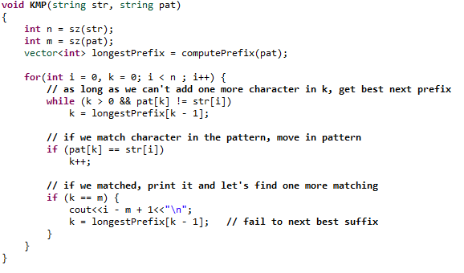
KMP Algorithm

Slide 26
Run Algorithm
KMP(aaaa, aa)= 0, 1, 2
KMP(ababacdab, aba) = 0, 2
KMP(abc, abc) = 0
KMP(abcabca, abca) = 0, 3

Slide 27
Failure Function Algorithm
How to do it efficiently?
Match the pattern against itself!
In other words, use similar code to KMP

Slide 28
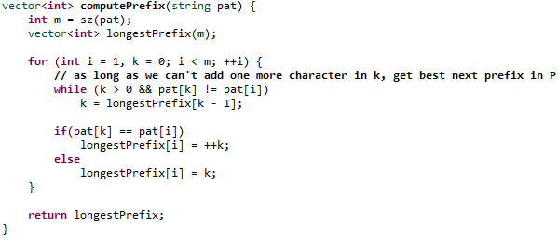
Failure Function Algorithm

Slide 29
“Failure” of ababcaba
0 | 0 | 1 | 2 | 0 | 1 | 2 | 3
If failed to match after 6th position,
Fail and try to match from 2nd position
a
b
a
b
c
a
b
a

Slide 30
Order Analysis
O(m) for failure function
O(n) for KMP matching
Overall: O(n+m) instead of O(nm)
Exercise1 : Simulate by hand examples to fully get it
Exercise2 : prove order

